Slide 1
STEP UP- Elements of College Writing 12
Class Outline

Slide 2
This class will be treated like a REAL college course.
By the end of the year, students will have a solid understanding about what it takes to succeed in college and what to expect.
This class will follow all the guidelines of the Basic Writing curriculum set by Westchester Community College.

Slide 3
How this class works:
This course is project-based. This means assignments are explained and given in class. We will discuss format, criteria and parameters. Students are expected to use classroom laptops to work in class. They will receive a class work grade and show their work on a daily basis.
LAPTOP PROTOCOL:
You are responsible for anything that happens to this laptop in class.
It is your responsibility to plug it in and charge it.
If it is tampered with in anyway, you will be held accountable for it.
Do not download anything onto this laptop.
These are for classroom use, not to watch the game, or you tube. If you are caught misusing or handling a laptop, your grade will reflect that .
Five people will be using your laptop. You are 1/5 who can be blamed if it has an issue.

Slide 4
WHO BELONGS here?
-Students who are college bound.
-12th grade students who have intentions of applying to colleges for Fall 2022 (Students may or may not be included.)
-Students who wish to bypass this class next year at WCC by getting a75 or better on selected assignments.
-Ptech Students who will take Ms. Mueller’s English 101/102.

Slide 5
What does this class offer?
Ptech students get 1 high school credit for English 11 if they pass this class. They must pass this class to walk the stage in June of 2023.
12th graders need this class as their last English credit in order to walk the stage in June 2022.
If 12th graders receive a 75 or better on selected assignments, they bypass the Accuplacer exam (Written essay) for Westchester Community College.
Ptech students go straight into English 101/102!
A great insight into the life of a real college student!
A lot of support in the college process.

Slide 6
Attendance
In a 3 credit semester courses, you only get 3 absences before you fail. In this class you get 7 absences a quarter. Any more than 7 and you fail no matter the excuse.
More than 24 absences in the year will make you fail this course and you will have to go to summer school. Therefore, you will not graduate with your peers. (Tell that one to your momma.)

Slide 7
Homework
Most assignments must be done on Teams.
You have 1 day to complete an assignment before it turns into a zero. No excuses.
This classes has VERY strict deadlines. This is not for you if you can’t hand in work on time.
All correspondence with me should be done via email.

Slide 8
Remind.com
Remind.com will only be used for reminders of college info etc. Please see the board to join!

Slide 9
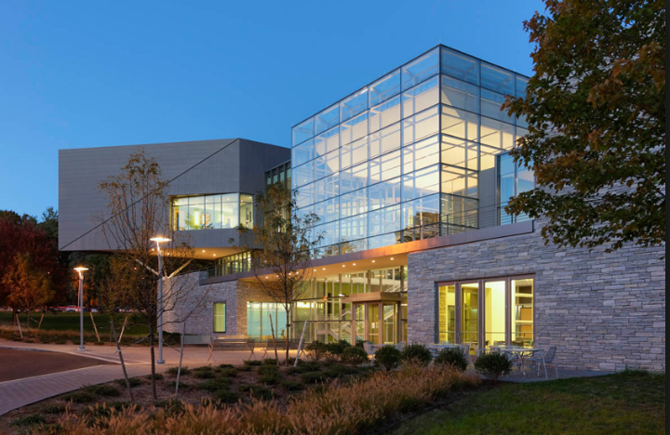
College Visits
I am not sure if WCC will allow campus tours this year. I will keep you posted.
Full-Time Tuition (12 credit hours or more per semester)
* Resident (per semester) | $2,190.00
Per year | $4,280.00
75 Grasslands Road Valhalla, NY 10595 Tel: (914) 606-6600

Slide 10
Exiting this class
Students must present their College Portfolio to an audience of their peers. Students must save all work on Teams.
PLEASE NOTE: I DO NOT NEGOTIATE GRADES. WCC holds me to a different standard besides the YPS standard when it comes to entering English 101 in college. They have the ultimate decision as to whether a student gains entrance to English 101.

Slide 11
Correspondence
For Google Drive: lydiaclark2015@gmail.com
For general correspondence: lclark@yonkerspublicschools.org

